Slide 1

In today’s competitive market, accurate sales forecasting is crucial for effective inventory management, optimizing marketing strategies, and improving overall customer satisfaction. Our company, which operates both online and offline sales channels, seeks to enhance its ability to predict future sales based on historical data and various influencing factors.
Binny Gill
Miniproject 3*

Slide 2
Steps to Prepare Data for Analysis
Data Collection
Gather data from shoppers_data and online_data.
Data Wrangling
Clean and transform data to address missing values and inconsistencies.
Data Integration
Merge shoppers_data and online_data into a single DataFrame.
Exploratory Data Analysis (EDA)
Analyze the dataset to uncover patterns and relationships.
Feature Engineering
Create new features to improve predictive power.
Data Splitting
Split the dataset into training and testing sets (e.g., 80/20 split).
Feature Scaling
Standardize features to ensure a similar scale.
Final Data Review
Check for any remaining issues before modeling.

Slide 3

Features After Data Cleaning
Key Features:
Gender: Customer gender (categorical)
Location: Customer's geographical location
Tenure_Months: Customer relationship duration (months)
Transaction_ID: Unique transaction identifier
Transaction_Date: Date of the transaction
Product_SKU: Unique product identifier
Quantity: Number of items purchased
Avg_Price: Average price per item
Revenue: Total revenue from the transaction

Slide 4

Correlation Insights
Correlated Features:
Tenure_Months: Strong positive correlation with the target variable (e.g., sales or revenue), indicating that longer customer tenure may be associated with higher spending.
Moderately Correlated Features:
Transaction_ID: Shows some correlation, but it's often unique and may not provide meaningful insights regarding spending behavior.
Quantity: As expected, this could indicate that higher quantities purchased correlate with increased revenue.
Least Correlated Features:
PageValues: Indicates minimal relationship with revenue, suggesting that page interactions may not directly influence spending.
Administrative: Shows low correlation, which may imply that administrative costs have little to do with sales outcomes in this context.

Slide 5
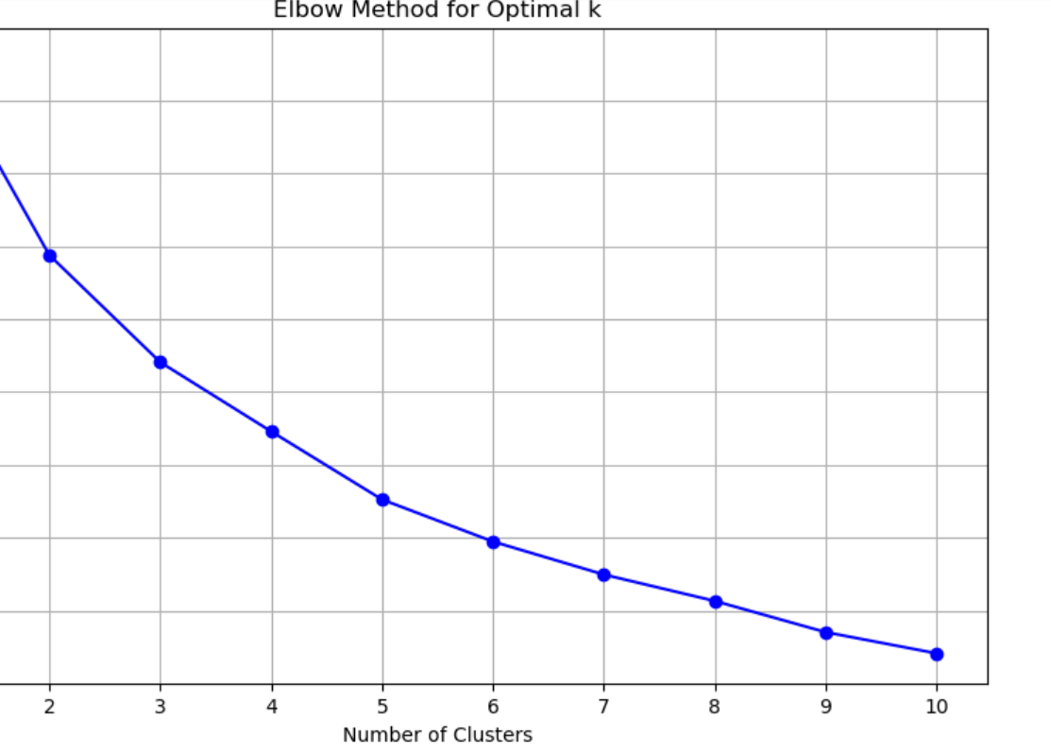
Unsupervised Machine Learning: Exploring Patterns and Insights in Data
Key Findings from the Elbow Curve
Number of Clusters: After analyzing the Elbow Curve, we determined that 10 clusters is optimal.
Inertia Trend:
As kkk increases, inertia decreases, indicating that the model is fitting the data better.
However, after a certain point (the "elbow"), the rate of decrease in inertia slows significantly. This point suggests diminishing returns on adding more clusters.
Spending Range:
Clusters identified have a spending range from 75,000 to 250,000.
Lower clusters may represent budget-conscious customers, while higher clusters represent premium or high-value customers.

Slide 6
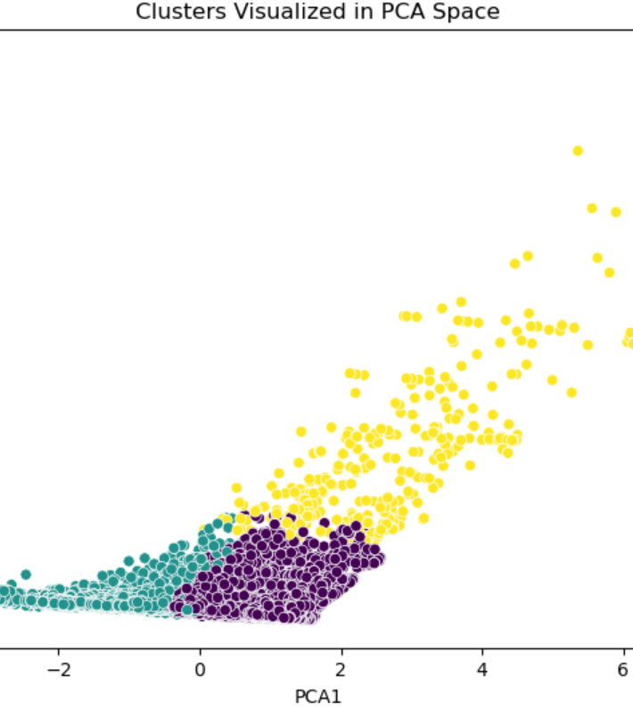
PCA Results and Insights
Key Findings
Three Clusters Identified:
Cluster 1: Located between -4 and 0 on the x-axis (lower spending).
Cluster 2: Ranges from 0 to 2 on the x-axis (moderate spending).
Cluster 3: Extends up to 30 on the y-axis (high-value and diverse customers).
Interpretation
These clusters highlight distinct customer segments, aiding targeted marketing strategies and enhancing engagement.

Slide 7
Silhouette Score Analysis
. Interpretation of a Score of 0.40
Indicates moderate clustering structure.
Clusters are somewhat distinct, but there’s room for improvement.
Some data points may be close to the decision boundaries between clusters.
lhouette Score: 0.40

Slide 8
Supervised Machine Learning Model Results Model: Random Forest Mean Squared Error (MSE): 27.71
Model Performance
Interpretation of MSE:
Indicates the average squared difference between predicted and actual values.
Lower values are better; MSE of 27.71 suggests moderate prediction accuracy.

Slide 9
Model: Neural Network Mean Squared Error (MSE): 2.91
Model Performance
MSE Interpretation:
Measures the average squared difference between predicted and actual values.
Lower MSE = Better accuracy: A score of 2.91 indicates strong performance.

Slide 10
Feature Importance Analysis
Insights
Top Influencers:
Offline_Spend and Online_Spend are the most significant features, accounting for over 99% of importance.
Low Impact Features:
Features like Quantity, GST, and Administrative show negligible impact on model performance.

Slide 12
Conclusion
Our analysis indicates that the Neural Network model demonstrates strong predictive capability with an MSE of 2.91. The feature importance results highlight that Offline_Spend and Online_Spend are the primary drivers of sales, contributing over 99% to predictions.
By focusing on these key areas, we can enhance sales forecasting accuracy, improve inventory management, and optimize marketing strategies, ultimately leading to greater customer satisfaction and a competitive edge in the market.

